Slide 1
Muscular Fitness
FNDN 102
Exercise is more than cardio!

Slide 2
Objectives
Why?
How does this impact your flourishing?
How?
Practical implementation
Personalized program design
Maximize: results, time-efficiency
Minimize: risk

Slide 3
Why do you lift?
For those that do…

Slide 4
Questions to Ponder…
Please answer at least one of the following…
What are you passionate about?
What do you think God is calling you to?
What is your why?

Slide 5
Introduction
Exerting muscular effort against resistance
Resistance could be:
Machines
Free weights (barbells, dumbbells)
Cables
Body weight
Bands
Other objects…

Slide 6
Strength & Scripture
Remember the context of scripture
Strength is valued in scripture
The glory of young men is their strength. Proverbs 20:29 (NIV)
She sets about her work vigorously; her arms are strong for her tasks. Proverbs 31:17 (NIV)
Your arm is endued with power; your hand is strong, your right hand exalted. Psalm. 89:13 (NIV)

Slide 7
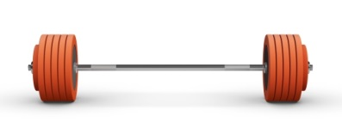
Part 1: Benefits of Resistance Training

Slide 8
Performance
Don’t just think athletes!
Work, sport, daily life, emergencies
Strength lays a foundation for performance
Speed, power, endurance, conditioning

Slide 9
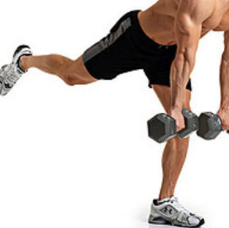
Injury Reduction
Improved strength-to-weight ratio
Muscle balance
Improved posture?
Improved stability (not machines)

Slide 10
Physical fitness
Muscular strength
Muscular endurance
Cardio?
Flexibility?
Body composition…

Slide 11
Body Composition
Old thinking
Increased metabolism
1lb muscle = 35-50 extra calories/day?
Increased EPOC?
Excess post-exercise oxygen consumption
Hormones?
Build lean muscle
Maintain lean muscle in calorie deficit
Energy in-efficiency
Better you get = more weight used = more calories burned
Research: it decreased body fat while maintaining lean muscle (Miller et al., 2018)
Better when combined with nutrition intervention

Slide 12
Aesthetics
Christy Harrison

Slide 13
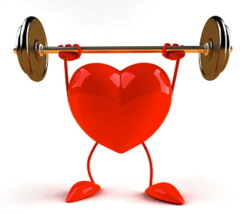
Health
Bone health
Increases bone density
Joint health
Reduced risk of fractures
Help prevent osteoporosis
Heart health
Reduced risk of heart disease
Brain health
Lower blood pressure
Reduce back pain
Reduced arthritis
Reduced fibromyalgia
Reduced cardiovascular disease
Lower risk of cancer
Possible lower risk of kidney cancer
Helps improve strength & muscle mass when undergoing chemotherapy
Reduced visceral fat
Reduced body fat
Best when combined with nutrition changes
Helps prevent sarcopenia
Helps prevent frailty
Reverse specific aging factors in skeletal muscle
Improved aerobic fitness
Improve lipid profiles
Increase glucose tolerance
Increased insulin sensitivity
Improve gastrointestinal transit time
Reduced risk of diabetes and metabolic syndrome
Reduced risk of cancer
Improved posture
Stronger immune system
Improved physical functioning
Reduction in all-cause mortality
Decreased risk of mortality…

Slide 14
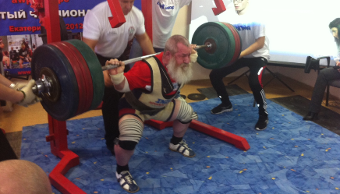
Strength & Mortality
The stronger live longer – independent of aerobic fitness
Greatest health benefits progressing from low to moderate strength levels
Do not need high-performance strength for health
Willardson & Tudor-Locke, 2005

Slide 15
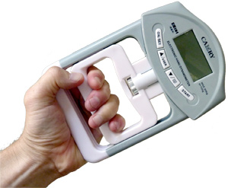
Significant association between mortality risk and loss of grip strength
Application:
Grip strength usually = total body strength
Some hand strength is important
Note:
Both weakness and asymmetry “are associated with future morbidity accumulation” (Klawitter et al., 2022)

Slide 16
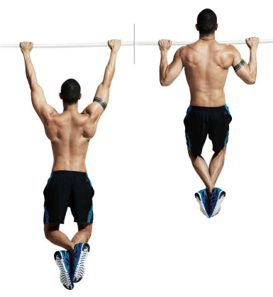
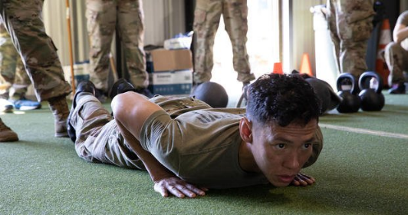
Greater relative strength = lower risk
Application:
Strength-to-weight ratio
Better push-up performance associated with lower CVD events (Yang et al., 2019)

Slide 17
Those demonstrating low performance in sit-ups had double the risk of those demonstrating high performance
Application:
Sit-ups are not that great for your lower back
Test of relative strength

Slide 18
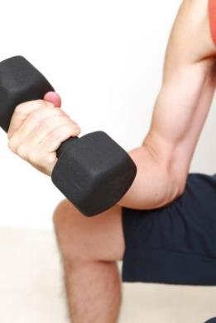
Being underweight and weak is a greater mortality risk than being overweight and strong
Application:
Training for size and strength and help you live longer

Slide 19
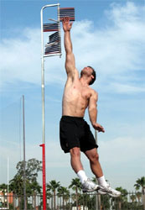
Those with low vertical jump were had double the risk of those with high performance
Application:
Power improves function
Power extends life expectancy
Keep some power training in your program
Sprints, jumps, throws, punching bag

Slide 20
More Mortality Research
1,755 elderly folks
Tested Strength
Followed 5.5 years for mortality and 3 years for hospitalization
Works strength scores compared to those with best strength scores
Males 2.5 times more likely to die
Females 4.4 times more likely to die
Hospitalization risk
Males 1.8 times more likely to be in the hospital
Females 2.8 times more likely to be in the hospital
Guadalupe-Grau et al., 2015

Slide 21
A Systematic Review and Meta-Analysis of Data From Approximately 2 Million Men and Women (García-Hermoso et al., 2018)
Conclusion:
“Higher levels of upper- and lower-body muscular strength are associated with a lower risk of mortality in adult population, regardless of age and follow-up period.”
Research (Patel et al., 2020)
“Engaging in ≥2 hours per week of MSA was associated with lower all-cause mortality, independent of aerobic activity.”

Slide 22
2022 Systematic Review and Meta-Analysis (Shailendra et al.)
Comparing no resistance training to any amount of resistance training
Reduced all-cause mortality by 15%
Reduced CVD by 19%
Reduced cancer mortality by 14%
Max risk reduction: 60 min/week

Slide 23
Strength, Muscle Mass & COVID-19
Research (Gil et al., 2021)
186 patients admitted to the hospital with moderate to severe COVID-19
Assessed grip strength and thigh muscle mass
Stronger grip associated with shorter hospital stay
Longer hospitalization stay with those with the smallest quads

Slide 24
Health Benefits of Muscle
Ability to independently predict survival in older adults (Srikanthan, & Karlamangla, 2014)
Improve glucose update into muscles (Wackerhage et al., 2022)
Negatively associated with type 2 diabetes mellitus and obesity (Wackerhage et al., 2022)
Muscle mass is significantly associated with maintaining metabolic health (Lee et al., 2019)
Lean body mass reduces mortality risk of cardiovascular disease, cancer, and respiratory disease (Lee et al., 2018)
Low muscle mass is associated with functional impairment and physical disability (Janssen et al., 2002)

Slide 25
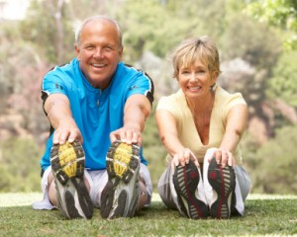
Aging Well
Lean muscle
Keeps metabolism up
Inversely associated with metabolic syndrome (Song et al., 2021)
Prevent Sarcopenia and improve mobility (Larsson et al., 2019, Chen et al., 2021)
Hormones?
Slows muscle aging (Melov, et al., 2007)
Improves: walking speed and endurance, lower body strength (Prevett, et al., 2022)

Slide 26
Strength (Fiatarone, et al., 1990)
“We conclude that high-resistance weight training leads to significant gains in muscle strength, size, and functional mobility among frail residents of nursing homes up to 96 years of age.”
Power (Caserotti et al., 2008)
Helps with preventing falls and disabilities
Power training offers a “modest” benefit over slow lifting for improving function (Balachandran et al., 2022)
Note: lifting weights fast and lowering under control
Combining multiple forms of exercise (including resistance training) helps with balance and reduces risk of injury (Bai et al., 2022)

Slide 27
Mark Rippetoe
"Strong people are harder to kill than weak people and more useful in general"

Slide 28
Impact on Flourishing
Service opportunities
Strength
Outer
Inner
Confidence
Reality check
The weights don’t lie
Real-life parallels
E.g. suffering → stronger, delayed gratification
“You are stronger than you think”
Remove mental restrictions

Slide 29
Application Activity:
Think back to your answer for the passion/why/calling question
Please write down the top 3-benefits that would help you with your answer
1)
2)
3)

Slide 30
Okay, but how much time will this take?
Minimal effective dose? (Steele et al., 2021 – note: not peer reviewed)
1x per week
1 set per exercise
6 exercises
Results plateaued in 1 year
Systematic review and meta-analysis on minimum effective dose to increase strength (Androulakis-Korakakis et al., 2019)
2-3x per week
1 set of 6-12 reps
Weight: 70-85% 1RM
Momentary muscular failure

Slide 31
Even 1x per week or less than 1 hour per week is associated with lower risk of cardiovascular disease and all-cause mortality (Liu et al., 2019)
Note: this is independent of aerobic fitness
Options based on your lifestyle & preferences (Fyfe et al., 2021)
Option 1: High intensity/loads, low volume and low frequency
Option 2: Lower intensity/loads, high frequency
Often done with minimal equipment (e.g. bodyweight, bands, dumbbells, rings/TRX)
“Exercise snacking”
Additional benefits: combating sedentary lifestyles associated poorer cardiometabolic health
See sample programs for examples

Slide 32
Part 2: Steps to Designing a Resistance Training Program

Slide 33
Step 1: Select Appropriate Exercises

Slide 34
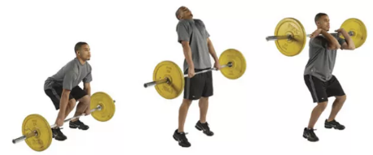
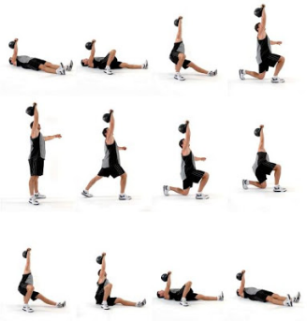
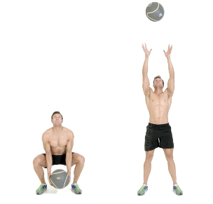
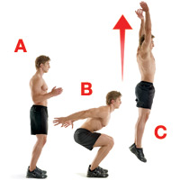
Total Body?
Olympic weightlifting variations, jumps/throws, sprints
Get-ups
Performance
Training body as a unit

Slide 35
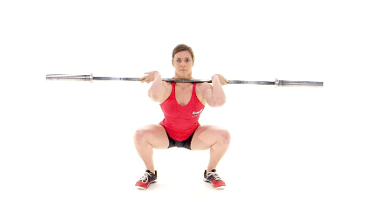
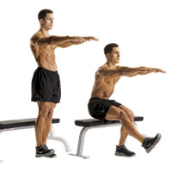
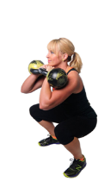
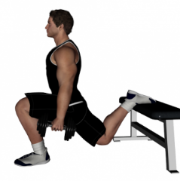
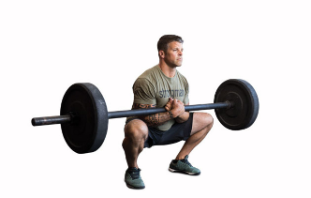
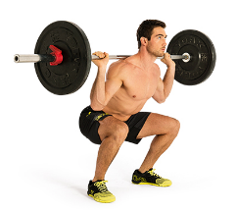
Squat
Squat, split squat, lunge & single leg squat variations

Slide 36
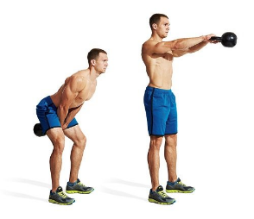
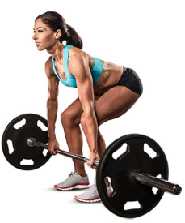
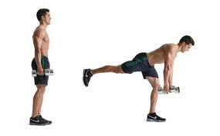
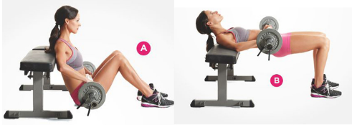
Hinge
Deadlift variations
Hip Thrusts
Swings

Slide 37
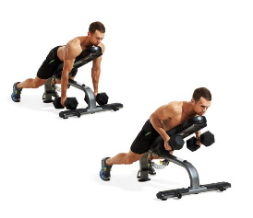
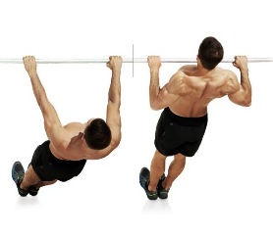
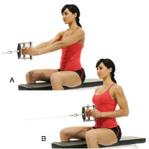
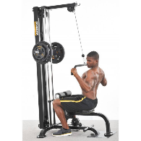
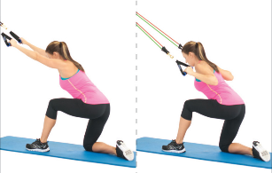
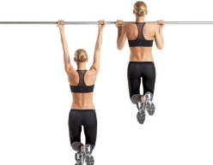
Pull
Horizontal pull (rows)
Vertical pull (pull-up, pull-down)

Slide 38
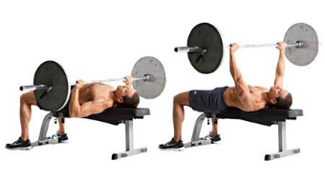
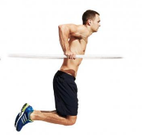
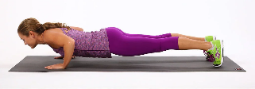
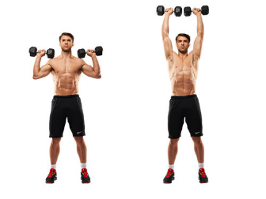
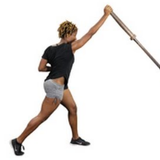
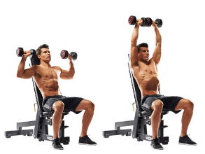
Push
Horizontal push (push-ups, bench press, dips)
Vertical push (overhead & high incline pressing)

Slide 39
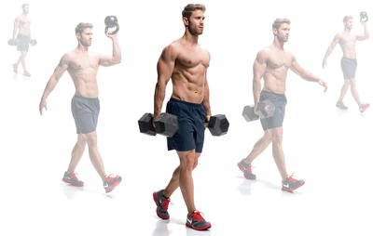
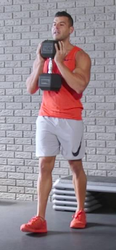
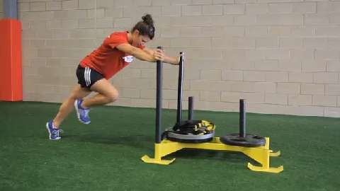
Carries
Farmers walks, other walks, sleds, strongman
Simple, functional strength, connects your whole body

Slide 40
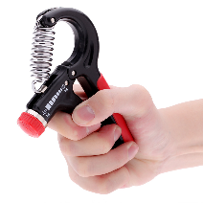
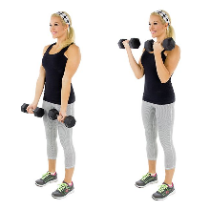
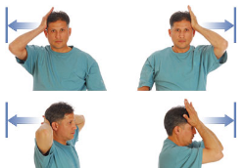
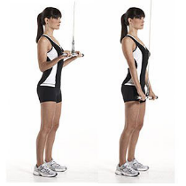
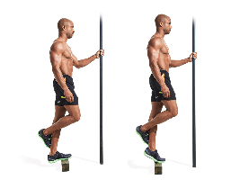
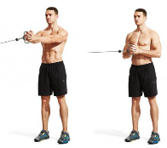
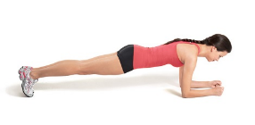
Accessories
Core, arms, calves, neck, grip etc.
Extra attention to a specific area
Functional or aesthetic
Note: must be in addition to the main movements – not a replacement!

Slide 41
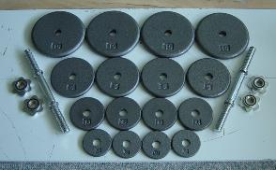
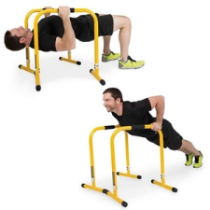
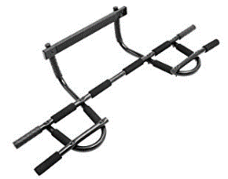
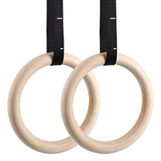
Home Body Weight Training
Discussion: benefits?
Challenges
Fixed weight
Progressive overload
Hitting the non-mirror muscles
Great additions:
Adjustable dumbbells
Doorway chin-up bar
Rings
Bands
Equalizer?
More info: http://www.andrewheming.com/2017/10/home-gym-set-up-guide-bonus-free.html
FNDN 102 lab

Slide 42
Our Home Gym

Slide 43
Step 2: Weekly Layout of Movements

Slide 44
Goals & Weekly Layouts
Beginner
Whole body
General Fitness
Whole body circuit, Push/Pull/Leg
Time Crunch
The Minimalist, Whole body circuit, Push/Pull/Leg, Upper/Lower, Hinge & Push, Squat & Pull
Fat Loss
Whole body circuit, Push/Pull/Leg, Upper/Lower, Hinge/Push & Squat/Pull
Muscle Gain
Upper/Lower, Advanced Upper/Lower, Push/Pull, Movement Split, Body Part Split
Performance
Push/Pull/Leg, Upper/Lower, Advanced Upper/Lower, Hinge/Push & Squat/Pull, Movement Split
Bonus!
See sample programs at the end of the slides

Slide 45
Step 3: Exercise Order Tips
Warm-up first!
Low rep before high reps
Low rep: strength, speed, power
Medium to high rep: hypertrophy, endurance
High skill before low skilled
Big muscles before small muscles
Advanced: high priority before low priority
Do cardio at a different time
Remember: “tips” not “rules”

Slide 46
Exercise Order Options
Option 1: Standard training
Each exercise done by itself
Do all sets of one exercise, then move on to next exercise
Great for focus
Great for simplicity
Great in a busy gym
Great for “big” exercises (e.g. deadlifts)

Slide 47
Option 2: Alternating sets
Cut training time almost in half!
2 non-competing exercises
First exercise, short rest, second exercise, short rest, repeat for desired # of sets
Alternating upper/lower
Example: Squats & Chin-Ups
Alternating opposite muscles
Example: Bench Press & Rows

Slide 48
Option 3: Circuits
Many uses – for many goals – adjust training variables
Example:
1a) Ring Rows
1b) Reverse Lunge
1c) Push-Up
1d) Kettlebell Swings
1e) Swiss Ball Stir the Pot
http://www.andrewheming.com/2013/09/the-many-uses-of-circuit-training.html
Bonus Note: You can also use a combination of straight sets, alternating & circuits in the same workout!

Slide 49
Step 4: Select Reps & Loads
Use goals to determine rep range
1-5 – maximal strength
6-8 – strength/hypertrophy
9-12 – hypertrophy or strength endurance
13-20 – endurance
Note: rep ranges not set in stone
Weight that allows proper form for desired # of reps = proper training load (weight)
Crazy Important: progressive overload!!!

Slide 50
Step 5: Select # of Sets
Adjusts volume (i.e. amount of work)
More:
High-skilled movements
Building muscle
Functional hypertrophy
5x5, 8x3, 6x4, 10x3, 8x5 (sets x reps)
Less:
Strength without size gains
2x5, 3x3, 5x2, 6x1 (sets x reps)
Recovery constraints
Time constraints
Considerations
Individuality
Minimal effective dose
Recovery capacity/opportunity

Slide 51
Step 6: Select Rest Intervals
Influences training stress
Think: continuum
Short rest (incomplete rest)
<60 sec
Endurance
Conditioning
Full Recovery (complete rest)
2-5 min
Max strength or power
Hypertrophy (2-3min)
Notes:
Don’t turn weights into cardio! Don’t fear rest!
Time ranges are for straight sets – you can do other non-competing exercises during this time

Slide 52
For More Info:
Ask questions any time: Andrew.Heming@twu.ca
Free articles: www.AndrewHeming.com
Exercise video library: www.YouTube.com/HemingTraining
Courses that count as part of your “core”
HKIN 103 – Weight Training (1 credit)
Women’s only section
HKIN 107 – Advanced Weight Training (1 credit)
HKIN 201 – Strength & Conditioning (3 credits)

Slide 53
Women & Weight Training
Don’t miss out because of fear or intimidation
Don’t worry about “bulking up”
Sex differences, programming, diet, drug use
Challenge traditional lifting-related gender stereotypes
No “man exercises” or “women exercises”
Lifting heavy, lifting face, building muscle
Take a weight training course
HKIN 103 (co-ed or women’s only)
Consider where you train
School, home, public gym, rec centre
Consider: target market of that gym
Women’s only gyms?
Equipment? Quality of instruction?

Slide 54
Bonus Section: Sample Programs
Note: these are samples for educational purposes, not individual exercise prescriptions

Slide 55
Sample Program Guide
Beginner
Whole body
General Fitness
Whole body circuit, Push/Pull/Leg
Time Crunch
Minimalist, Whole body circuit, Push/Pull/Leg, Upper/Lower, Hinge & Push, Squat & Pull
Fat Loss
Whole body circuit, Push/Pull/Leg, Upper/Lower, Hinge/Push & Squat/Pull
Muscle Gain
Upper/Lower, Advanced Upper/Lower, Push/Pull, Movement Split, Body Part Split
Performance
Push/Pull/Leg, Upper/Lower, Advanced Upper/Lower, Hinge/Push & Squat/Pull, Movement Split
Bonus!
Check out the following sample programs…

Slide 56
Whole Body Routines
Train all muscle groups in one session
Beginners
Fat loss
General fitness
Time crunch
2-3x per week

Slide 57
Sample Beginner Program
1) Goblet Squat: 2-3x6-10, rest 60-90s
2a) Lat Pulldown: 2-3x8-12, rest30-45s
2b) 1-Arm DB Press from ½ Kneel: 2-3x6-10, rest 30-45s
3) Weighted Hip Hinge: 2-3x6-10, rest 60-90s
4a) Seated Cable Row: 2-3x8-12, rest 30-45s
4b) Push-Up (from bar): 2-3x6-10, rest 30-45s
5) 1-Arm Farmer’s walk: 2-3x20-40meters, rest 60-90s

Slide 58
The Minimalist – Low Frequency
Day 1
1) Squat: 1-3x6-10
2a) 1-Arm DB Row: 1-3x6-10
2b) Bench Press: 1-3x6-10
3) 1-2 accessories: 1x8-15 (optional)
Day 2
1) Deadlift: 1-3x6-10
2a) Chin-up: 1-3x6-10
2b) 1-Arm DB Shoulder Press: 1-3x6-10
3) 1-2 accessories: 1x8-15 (optional)

Slide 59
The Minimalist - Exercise Snacking
Guidelines
4-6 days per week
Choose exercises with minimal equipment
Body weight, bands, dumbbells, rings/TRX
Exercises: each day do:
Upper body pull/upper back
Upper body push
One leg
Possibly 1-2 accessories (optional)
Do all at once or one at a time throughout the day
Do 1 set of 15-30 reps

Slide 60
The Minimalist - Exercise Snacking
Examples…
Monday: 1-Arm DB Row (elbow in), Push-Up, Goblet Squat
Tuesday: 1-Arm Band Pulldown, 1-Arm DB Shoulder Press, Single Leg Hip Thrust
Wednesday: YLTW Iso Holds, Chair Dip, Reverse Lunge
Thursday: 1-Arm DB Row (elbow out), 1-Arm Band Chest Press, Sliding Leg Curls
Friday: Chin-Up (leg assisted if needed), Pike Push-Up, Single Leg Squat from Chair
Saturday: Band Pull Aparts, 1-Arm DB Floor Press, Single Leg Romanian Deadlift

Slide 61
Sample General Fitness Circuit Express (Home or Gym)
1a) Reverse Lunge: 1-3 x 8-12 each leg, rest 20-30sec
1b) 1-Arm Band/Cable Pulldown: 1-3x8-15, rest 20-30sec
1b) 1-Arm Dumbbell/Band/Kettlebell Press: 1-3x8-12, rest 20-30sec
1c) Single Leg Dumbbell Romanian Deadlift: 1-3x10-15, rest 20-30sec
1d) 1-Arm Dumbbell Row: 1-3x10-15, rest 20-30sec
1e) 1-Arm Dumbbell Floor Press: 1-3x8-12, rest 20-30sec
1f) Goblet Carry: 1-3x40 meters, rest 30sec
1g) Dead Bug with Squeeze (core): 1-3x5-10 each side, rest 2min

Slide 62
A/B Whole Body
2 different whole body routines - alternated
Uses: intermediates, fat loss, athletes, time-efficiency
3x per week:
2x per week:
Week # | Mon | Tues | Wed | Thurs | Fri | Sat | Sun
1 | A |  | B |  | A
2 | B |  | A |  | B
Mon | Tues | Wed | Thurs | Fri | Sat | Sun
A |  |  | B

Slide 63
A/B Whole Body Example
All movements each day but different exercises
1) Front Squat
2a) Press
2b) Chin-up
3) Single Leg Romanian Deadlift
4a) Push-Ups
4b) Seated Cable Row
5) Accessories
1) Deadlift
2a) Bench Press
2b) 1-Arm DB Row
3) Reverse Lunge
4a) DB Shoulder Press
4b) Lat Pulldown
5) Accessories

Slide 64
A/B: Pull, Push, Leg
½ movements on A session and other ½ on B
1a) Deadlift
1b) Chin-Up
1c) Dip
2) Other? Examples:
Loaded carries
Accessories
Conditioning
Life
1a) Squat
1b) Prone DB Row
1c) Press
2) Other? Examples:
Loaded carries
Accessories
Conditioning
Life

Slide 65
A, B, C: Pull, Push, Leg
Like A/B whole body, but more advanced
Push, pull & legs 3x per week, different patterns
Example:
Day 1: chin-up, dip, deadlift, accessories
Day 2: Inverted Row, shoulder press, lunge, accessories
Day 3: 1-Arm DB Row, DB bench press, squat, accessories
Can be done as a circuit
Option: different rep ranges
Day 1: 8x3, Day 2: 5x5, Day 3: 4x8-10
Reference: Chad Waterbury

Slide 66
Push/Pull
Minimal overlap
Legs each day, but upper body emphasis
Great for muscle building, strength training or general fitness
Flexible weekly training schedule

Slide 67
Day 1:
Deadlift
Pull-Up
Row
Biceps
Core
Day 2:
Squat/Lunge
Shoulder Press
Bench Press
Triceps
Calves

Slide 68
Hinge & Push, Squat & Pull
Great for pairing upper and lower body exercises
General fitness, time efficiency, athletes, fat loss
Day 1:
Hinge (double & single leg)
Push (vertical & horizontal)
Day 2:
Squat (double & single leg)
Pull (vertical & horizontal)

Slide 69
Day 1:
1a) Single Leg Kettlebell Deadlift
1b) 1-Arm DB Press
2a) Romanian Deadlift
2b) Push-Up
3) Conditioning or accessories
Day 2:
1a) Front Squat
1b) Pull-Up
2a) Reverse Lunge
2b) Ring Row
3) Conditioning or accessories

Slide 70
Upper/Lower Split
Split exercise days to train upper body one day, lower body the next
Great for strength training
Great for athletes (male?)
Great for muscle gaining
Flexible weekly training
schedule

Slide 71
Upper/Lower Options
Mon | Tues | Wed | Thurs | Fri | Sat | Sun
Lower | Upper |  | Lower | Upper
Mon | Tues | Wed | Thurs | Fri | Sat | Sun
Lower |  | Upper |  | Lower | Upper
Week # | Mon | Tues | Wed | Thurs | Fri | Sat | Sun
1 | Lower |  | Upper |  | Lower
2 | Upper |  | Lower |  | Upper

Slide 72
Sample Upper/Lower
Lower Body
Upper Body
1) Jumps/Sprints
2a) Front Squat: 3x5
2b) Ball Leg Curl: 3x5
3) Split Squat: 2-3x8-10
4) Back Ext: 2-3x8-10
5) Accessories (e.g. calves, core)
1a) Chin-Up: 3x5-8
1b) Press: 3x5-8
2a) Prone DB Row: 3x8-10
2b) Incline DB Press: 3x8-10
3) Accessories (e.g. arms, shoulders)

Slide 73
Advanced Upper/Lower
4 different days
Different exercises each day
Example 1: Heavy/Speed
Day 1: Heavy Lower (strength focus)
Day 2: Heavy Upper (strength focus)
Day 3: Speed Lower (speed/power focus & accessories)
Day 4: Speed Upper (speed/power focus & accessories)
Example 2: Heavy/Rep
Day 1: Heavy Lower (strength focus)
Day 2: Heavy Upper (strength focus)
Day 3: Rep Lower (muscle building focus)
Day 4: Rep Upper (muscle building focus)

Slide 74
Movement Splits
Only a few movements each day
Uses: advanced strength & functional hypertrophy, structural balance (better than body-part splits)
Example:
Day 1: Hinge
Day 2: Vertical Push & Pull
Day 3: Rest
Day 4: Squat
Day 5: Horizontal Push/Pull
Day 6 & 7: Rest

Slide 75
Movement Split Example
Hinge Day
1a) Deadlift: 5x3
1b) Sprints: 5x10meter
2) Single Leg RDL: 4x8
3) Accessories
Vertical Push/Pull Day
1a) Chin-Ups: 5x3
1b) Push Press: 5x3
2a) Ring Pull-Up: 4x8
2b) DB Press: 4x8
3) Accessories
Squat Day
1a) Front Squat: 5x3
1b) Jump Squat: 5x2-3
2) Reverse Lunge: 4x8
3) Accessories
Horizontal Push/Pull Day
1a) 1-Arm DB Row: 5x5
1b) Bench Press: 5x3
2a) Prone DB Row: 4x8
2b) Incline DB Press: 4x8
3) Accessories

Slide 76
Body Part Splits/Bro Splits
Splitting up the body parts to train only some parts each day
2-4 exercises per body part
Great for advanced bodybuilding
Example:
Day 1: Back
Day 2: Shoulders & Triceps
Day 3: Legs & Abs
Day 4: Chest & Biceps

Slide 77
Sample Body Part/Bro Split
Day 1: Back
Trap Bar Deadlift: 2-3x5
Trap Bar Bent-Over Row: 3x6-10
Neutral Pull-Ups: 50 total reps (as many sets as it takes)
1-Arm DB Rows: 3x10-12
Face Pulls: 2x15-20
Farmer’s Walks: 3x40meters or Snatch Grip Shrugs: 3x8-12
Day 2: Shoulders & Triceps
DB Press: 3x6-8
DB High Pull: 3x8-10
Side DB Raises: 3x15-20
Dips or Close-Grip Bench Press: 3x6-8
EZ Incline Overhead Triceps Extensions: 3x8-10
Rope Pressdowns: 2-3x12-15

Slide 78
Day 3: Legs
Squats: 3x8-10
Bulgarian Split Squats or Leg Press: 3x12-15
Leg Curls: 3x6-8
Romanian Deadlifts: 3x12-15
Calf Raises: 3x8-10
Seated Calf Raise: 2x20-25
Day 4: Chest & Biceps
Incline Bench Press: 3x5-8
Low-Incline DB Bench Press: 3x8-10
Ring Dips: 3x6-10
Chin-Ups: 3x5-8
Close-Grip EZ Curls: 3x8-10
Incline DB Curls: 3x8-10

Slide 79
Questions?
Ask anytime ☺

Slide 80
References
Androulakis-Korakakis, P., Fisher, J. P., & Steele, J. (2019). The Minimum Effective Training Dose Required to Increase 1RM Strength in Resistance-Trained Men: A Systematic Review and Meta-Analysis. Sports Medicine, 50(4), 751–765. https://doi.org/10.1007/s40279-019-01236-0
Bai, X., Soh, K. G., Omar Dev, R. D., Talib, O., Xiao, W., Soh, K. L., Ong, S. L., Zhao, C., Galeru, O., & Casaru, C. (2022). Aerobic Exercise Combination Intervention to Improve Physical Performance Among the Elderly: A Systematic Review. Frontiers in physiology, 12, 798068. https://doi.org/10.3389/fphys.2021.798068
Balachandran, A. T., Steele, J., Angielczyk, D., Belio, M., Schoenfeld, B. J., Quiles, N., Askin, N., & Abou-Setta, A. M. (2022). Comparison of Power Training vs Traditional Strength Training on Physical Function in Older Adults: A Systematic Review and Meta-analysis. JAMA network open, 5(5), e2211623. https://doi.org/10.1001/jamanetworkopen.2022.11623
Caserotti, P., Aagaard, P., Larsen, J. B., & Puggaard, L. (2008). Explosive heavy-resistance training in old and very old adults: changes in rapid muscle force, strength and power. Scandinavian journal of medicine & science in sports, 18(6), 773–782. https://doi.org/10.1111/j.1600-0838.2007.00732.x
Chen, N., He, X., Feng, Y., Ainsworth, B. E., & Liu, Y. (2021). Effects of resistance training in healthy older people with sarcopenia: a systematic review and meta-analysis of randomized controlled trials. European review of aging and physical activity : official journal of the European Group for Research into Elderly and Physical Activity, 18(1), 23. https://doi.org/10.1186/s11556-021-00277-7
Church, D.D., et al. (1985, Epub 2016). Comparison of high-intensity vs. high-volume resistance training on the BDNF response to exercise. Journal of Applied Physiology, 121(1), 123-128.

Slide 81
El-Kotob, R., Ponzano, M., Chaput, J., Janssen, I., Kho, M. E., Poitras, V. J., . . . Giangregorio, L. M. (2020). Resistance training and health in adults: An overview of systematic reviews. Applied Physiology, Nutrition, and Metabolism, 45(10 (Suppl. 2)). doi:10.1139/apnm-2020-0245
Fagard, R.H. (2006). Exercise is good for your blood pressure: effects of endurance training and resistance training. Clinical and Experimental Pharmacology and Physiology, 33(9), 853-856.
Fiatarone, M. A., Marks, E. C., Ryan, N. D., Meredith, C. N., Lipsitz, L. A., & Evans, W. J. (1990). High-intensity strength training in nonagenarians. Effects on skeletal muscle. JAMA, 263(22), 3029–3034.
Fraser, B. J., Blizzard, L., Buscot, M. J., Schmidt, M. D., Dwyer, T., Venn, A. J., & Magnussen, C. G. (2022). Muscular strength measured across the life-course and the metabolic syndrome. Nutrition, metabolism, and cardiovascular diseases : NMCD, 32(5), 1131–1137. https://doi.org/10.1016/j.numecd.2022.01.018
Fyfe, J. J., Hamilton, D. L., & Daly, R. M. (2021). Minimal-Dose Resistance Training for Improving Muscle Mass, Strength, and Function: A Narrative Review of Current Evidence and Practical Considerations. Sports medicine (Auckland, N.Z.), 10.1007/s40279-021-01605-8. Advance online publication. https://doi.org/10.1007/s40279-021-01605-8
García-Hermoso, A., Cavero-Redondo, I., Ramírez-Vélez, R., Ruiz, J. R., Ortega, F. B., Lee, D. C., & Martínez-Vizcaíno, V. (2018). Muscular Strength as a Predictor of All-Cause Mortality in an Apparently Healthy Population: A Systematic Review and Meta-Analysis of Data From Approximately 2 Million Men and Women. Archives of physical medicine and rehabilitation, 99(10), 2100–2113.e5. https://doi.org/10.1016/j.apmr.2018.01.008

Slide 82
Gil, S., Jacob Filho, W., Shinjo, S. K., Ferriolli, E., Busse, A. L., Avelino-Silva, T. J., Longobardi, I., de Oliveira Júnior, G. N., Swinton, P., Gualano, B., Roschel, H., & HCFMUSP COVID-19 Study Group (2021). Muscle strength and muscle mass as predictors of hospital length of stay in patients with moderate to severe COVID-19: a prospective observational study. Journal of cachexia, sarcopenia and muscle, 10.1002/jcsm.12789. Advance online publication. https://doi.org/10.1002/jcsm.12789
Guadalupe-Grau, A., Carnicero, J. A., Gómez-Cabello, A., Gutiérrez Avila, G., Humanes, S., Alegre, L. M., Castro, M., Rodríguez-Mañas, L., & García-García, F. J. (2015). Association of regional muscle strength with mortality and hospitalisation in older people. Age and ageing, 44(5), 790–795. https://doi.org/10.1093/ageing/afv080
Guadalupe-Grau, A., Fuentes, T., Guerra, B., & Calbet, J.A. (2009). Exercise and bone mass in adults. Sports Medicine (Auckland, NZ), 39(6), 439-468.
Hamill, B.P. (1994). Relative safety of weightlifting and weight training. Journal of Strength and Conditioning Research, 8(1), 53-57.
Hollings, M., Mavros, Y., Freeston, J., & Singh, M. F. (2017). The effect of progressive resistance training on aerobic fitness and strength in adults with coronary heart disease: A systematic review and meta-analysis of randomised controlled trials. European Journal of Preventive Cardiology, 24(12), 1242-1259. doi:10.1177/2047487317713329
Janssen, I., Heymsfield, S. B., & Ross, R. (2002). Low relative skeletal muscle mass (sarcopenia) in older persons is associated with functional impairment and physical disability. Journal of the American Geriatrics Society, 50(5), 889–896. https://doi.org/10.1046/j.1532-5415.2002.50216.x

Slide 83
Khalafi, M., Malandish, A., Rosenkranz, S. K., & Ravasi, A. A. (2021). Effect of resistance training with and without caloric restriction on visceral fat: A systemic review and meta-analysis. Obesity reviews : an official journal of the International Association for the Study of Obesity, 22(9), e13275. https://doi.org/10.1111/obr.13275
Kim, J. S., Wilson, R. L., Taaffe, D. R., Galvão, D. A., Gray, E., & Newton, R. U. (2022). Myokine Expression and Tumor-Suppressive Effect of Serum after 12 wk of Exercise in Prostate Cancer Patients on ADT. Medicine and science in sports and exercise, 54(2), 197–205. https://doi.org/10.1249/MSS.0000000000002783
Kjaer, M. (2004). Role of extracellular matrix in adaptation of tendon and skeletal muscle to mechanical loading. Physiological Reviews, 84(2), 649-698.
Klawitter, L., Vincent, B. M., Choi, B. J., Smith, J., Hammer, K. D., Jurivich, D. A., Dahl, L. J., & McGrath, R. (2022). Handgrip Strength Asymmetry and Weakness Are Associated With Future Morbidity Accumulation in Americans. Journal of strength and conditioning research, 36(1), 106–112. https://doi.org/10.1519/JSC.0000000000004166
Kraemer, W.J., Ratamess, N.A., & French, D.N. (2002). Resistance training for health and performance. Current Sports Medicine Reports, 1(3), 165–171.
Larsson, L., Degens, H., Li, M., Salviati, L., Lee, Y. I., Thompson, W., Kirkland, J. L., & Sandri, M. (2019). Sarcopenia: Aging-Related Loss of Muscle Mass and Function. Physiological reviews, 99(1), 427–511. https://doi.org/10.1152/physrev.00061.2017

Slide 84
Lee, D. H., Keum, N., Hu, F. B., Orav, E. J., Rimm, E. B., Willett, W. C., & Giovannucci, E. L. (2018). Predicted lean body mass, fat mass, and all cause and cause specific mortality in men: prospective US cohort study. BMJ (Clinical research ed.), 362, k2575. https://doi.org/10.1136/bmj.k2575
Lee, M. J., Kim, E. H., Bae, S. J., Choe, J., Jung, C. H., Lee, W. J., & Kim, H. K. (2019). Protective role of skeletal muscle mass against progression from metabolically healthy to unhealthy phenotype. Clinical endocrinology, 90(1), 102–113. https://doi.org/10.1111/cen.13874
Liu, Y., Lee, D. C., Li, Y., Zhu, W., Zhang, R., Sui, X., Lavie, C. J., & Blair, S. N. (2019). Associations of Resistance Exercise with Cardiovascular Disease Morbidity and Mortality. Medicine and science in sports and exercise, 51(3), 499–508. https://doi.org/10.1249/MSS.0000000000001822
Mazzilli, K. M., Matthews, C. E., Salerno, E. A., & Moore, S. C. (2019). Weight Training and Risk of 10 Common Types of Cancer. Medicine and science in sports and exercise, 51(9), 1845–1851. https://doi.org/10.1249/MSS.0000000000001987
McArdle, WD, Katch, FI & Katch, VL. (2015). Exercise Physiology: Nutrition, energy, and human performance. 8th ed. New York: Wolters Kluwer.
McGovern, A., Mahony, N., Mockler, D., & Fleming, N. (2022). Efficacy of resistance training during adjuvant chemotherapy and radiation therapy in cancer care: a systematic review and meta-analysis. Supportive care in cancer : official journal of the Multinational Association of Supportive Care in Cancer, 10.1007/s00520-021-06708-6. Advance online publication. https://doi.org/10.1007/s00520-021-06708-6

Slide 85
Melov, S., Tarnopolsky, M. A., Beckman, K., Felkey, K., & Hubbard, A. (2007). Resistance exercise reverses aging in human skeletal muscle. PloS one, 2(5), e465. https://doi.org/10.1371/journal.pone.0000465
Miller, T., Mull, S., Aragon, A. A., Krieger, J., & Schoenfeld, B. J. (2018). Resistance Training Combined With Diet Decreases Body Fat While Preserving Lean Mass Independent of Resting Metabolic Rate: A Randomized Trial. International journal of sport nutrition and exercise metabolism, 28(1), 46–54. https://doi.org/10.1123/ijsnem.2017-0221
Momma, H., Kawakami, R., Honda, T., & Sawada, S. S. (2022). Muscle-strengthening activities are associated with lower risk and mortality in major non-communicable diseases: a systematic review and meta-analysis of cohort studies. British journal of sports medicine, bjsports-2021-105061. Advance online publication. https://doi.org/10.1136/bjsports-2021-105061
Oftedal, S., Smith, J., Vandelanotte, C., Burton, N.W., & Duncan, M.J. (2019). Resistance training in addition to aerobic activity is associated with lower likelihood of depression and comorbid depression and anxiety symptoms: A cross sectional analysis of Australian women. Preventive Medicine, July 16:105773. doi: 10.1016/j.ypmed.2019.105773. [Epub ahead of print]
Patel, A. V., Hodge, J. M., Rees-Punia, E., Teras, L. R., Campbell, P. T., & Gapstur, S. M. (2020). Relationship Between Muscle-Strengthening Activity and Cause-Specific Mortality in a Large US Cohort. Preventing Chronic Disease, 17. https://doi.org/10.5888/pcd17.190408
Pratley, R., et. al. (1985, Epub 1994). Strength training increases resting metabolic rate and norepinephrine levels in healthy 50- to 65-yr-old men. Journal of Applied Physiology, 76(1), 133-137.

Slide 86
Prevett, C., Moncion, K., Phillips, S. M., Richardson, J., & Tang, A. (2022). Role of Resistance Training in Mitigating Risk for Mobility Disability in Community-Dwelling Older Adults: A Systematic Review and Meta-analysis. Archives of physical medicine and rehabilitation, S0003-9993(22)00360-4. Advance online publication. https://doi.org/10.1016/j.apmr.2022.04.002
Radaelli, R et. al. (2015). Dose-response of 1, 3, and 5 sets of resistance exercise on strength, local muscular endurance, and hypertrophy. Journal of Strength & Conditioning Research, 29(5), 1349–1358.
Russo, C.R. (2009). The effects of exercise on bone. Basic concepts and implications for the prevention of fractures. Clinical Cases in Mineral and Bone Metabolism, 6(3), 223–228.
Shailendra, P., Baldock, K. L., Li, L., Bennie, J. A., & Boyle, T. (2022). Resistance Training and Mortality Risk: A Systematic Review and Meta-Analysis. American journal of preventive medicine, S0749-3797(22)00176-3. Advance online publication. https://doi.org/10.1016/j.amepre.2022.03.020
Siff, M.C. (2003). Supertraining. Denver, CO: Supertraining Institute.
Simão, R., et. al. (2011). The influence of strength, flexibility, and simultaneous training on flexibility and strength gains. Journal of Strength and Conditioning Research, 25(5), 1333-1338.
Song, P., Han, P., Zhao, Y., Zhang, Y., Wang, L., Tao, Z., . . . Guo, Q. (2021). Muscle mass rather than muscle strength or physical performance is associated with metabolic syndrome in community-dwelling older Chinese adults. BMC Geriatrics, 21(1). doi:10.1186/s12877-021-02143-8
Srikanthan, P., & Karlamangla, A. S. (2014). Muscle mass index as a predictor of longevity in older adults. The American journal of medicine, 127(6), 547–553. https://doi.org/10.1016/j.amjmed.2014.02.007

Slide 87
Steele, J., Fisher, J., Giessing, J., Androulakis-Korakakis, P., Wolf, M., Kroeske, B., & Reuters, R. (2021). Long-term time-course of strength adaptation to minimal dose resistance training: Retrospective longitudinal growth modelling of a large cohort through training records. https://doi.org/10.31236/osf.io/eq485
Talar, K., Hernández-Belmonte, A., Vetrovsky, T., Steffl, M., Kałamacka, E., & Courel-Ibáñez, J. (2021). Benefits of Resistance Training in Early and Late Stages of Frailty and Sarcopenia: A Systematic Review and Meta-Analysis of Randomized Controlled Studies. Journal of Clinical Medicine, 10(8), 1630. https://doi.org/10.3390/jcm10081630
Westcott, W.L. (2012). Resistance training is medicine: effects of strength training on health. Current Sports Medicine Reports, 11(4): 209-216.
Umpierre, D., & Stein, R. (2007). Hemodynamic and vascular effects of resistance training: implications for cardiovascular disease. Arquivos Brasileiros de Cardiologia, 89(4), 256-262.
Wackerhage, H., Vechetti, I. J., Baumert, P., Gehlert, S., Becker, L., Jaspers, R. T., & de Angelis, M. H. (2022). Does a Hypertrophying Muscle Fibre Reprogramme its Metabolism Similar to a Cancer Cell?. Sports medicine (Auckland, N.Z.), 10.1007/s40279-022-01676-1. Advance online publication. https://doi.org/10.1007/s40279-022-01676-1
Willis, L.H., et. al. (1985, Epub 2012). Effects of aerobic and/or resistance training on body mass and fat mass in overweight or obese adults. Journal of Applied Physiology, 113(12), 1831-1837.

Slide 88
Willardson, J. M., & Tudor-Locke, C. (2005). Survival of the strongest: A brief review examining the association between muscular fitness and mortality. Strength and Conditioning Journal, 27(3), 80. https://doi.org/10.1519/1533-4295(2005)027[0080:sotsab]2.0.co;2
Winett, R.A., & Carpinelli, R.N. (2001). Review: potential health-related benefits of resistance training. Preventive Medicine, 33(5), 503-513.
Xiang, M.Q., et. al. (2019). Effect of a combined exercise and dietary Intervention on self-control in obese adolescents. Frontiers in Psychology, June 28;10:1385. doi: 10.3389/fpsyg.2019.01385.
Yang, J., Christophi, C. A., Farioli, A., Baur, D. M., Moffatt, S., Zollinger, T. W., & Kales, S. N. (2019). Association Between Push-up Exercise Capacity and Future Cardiovascular Events Among Active Adult Men. JAMA network open, 2(2), e188341. https://doi.org/10.1001/jamanetworkopen.2018.8341

